Slide 1
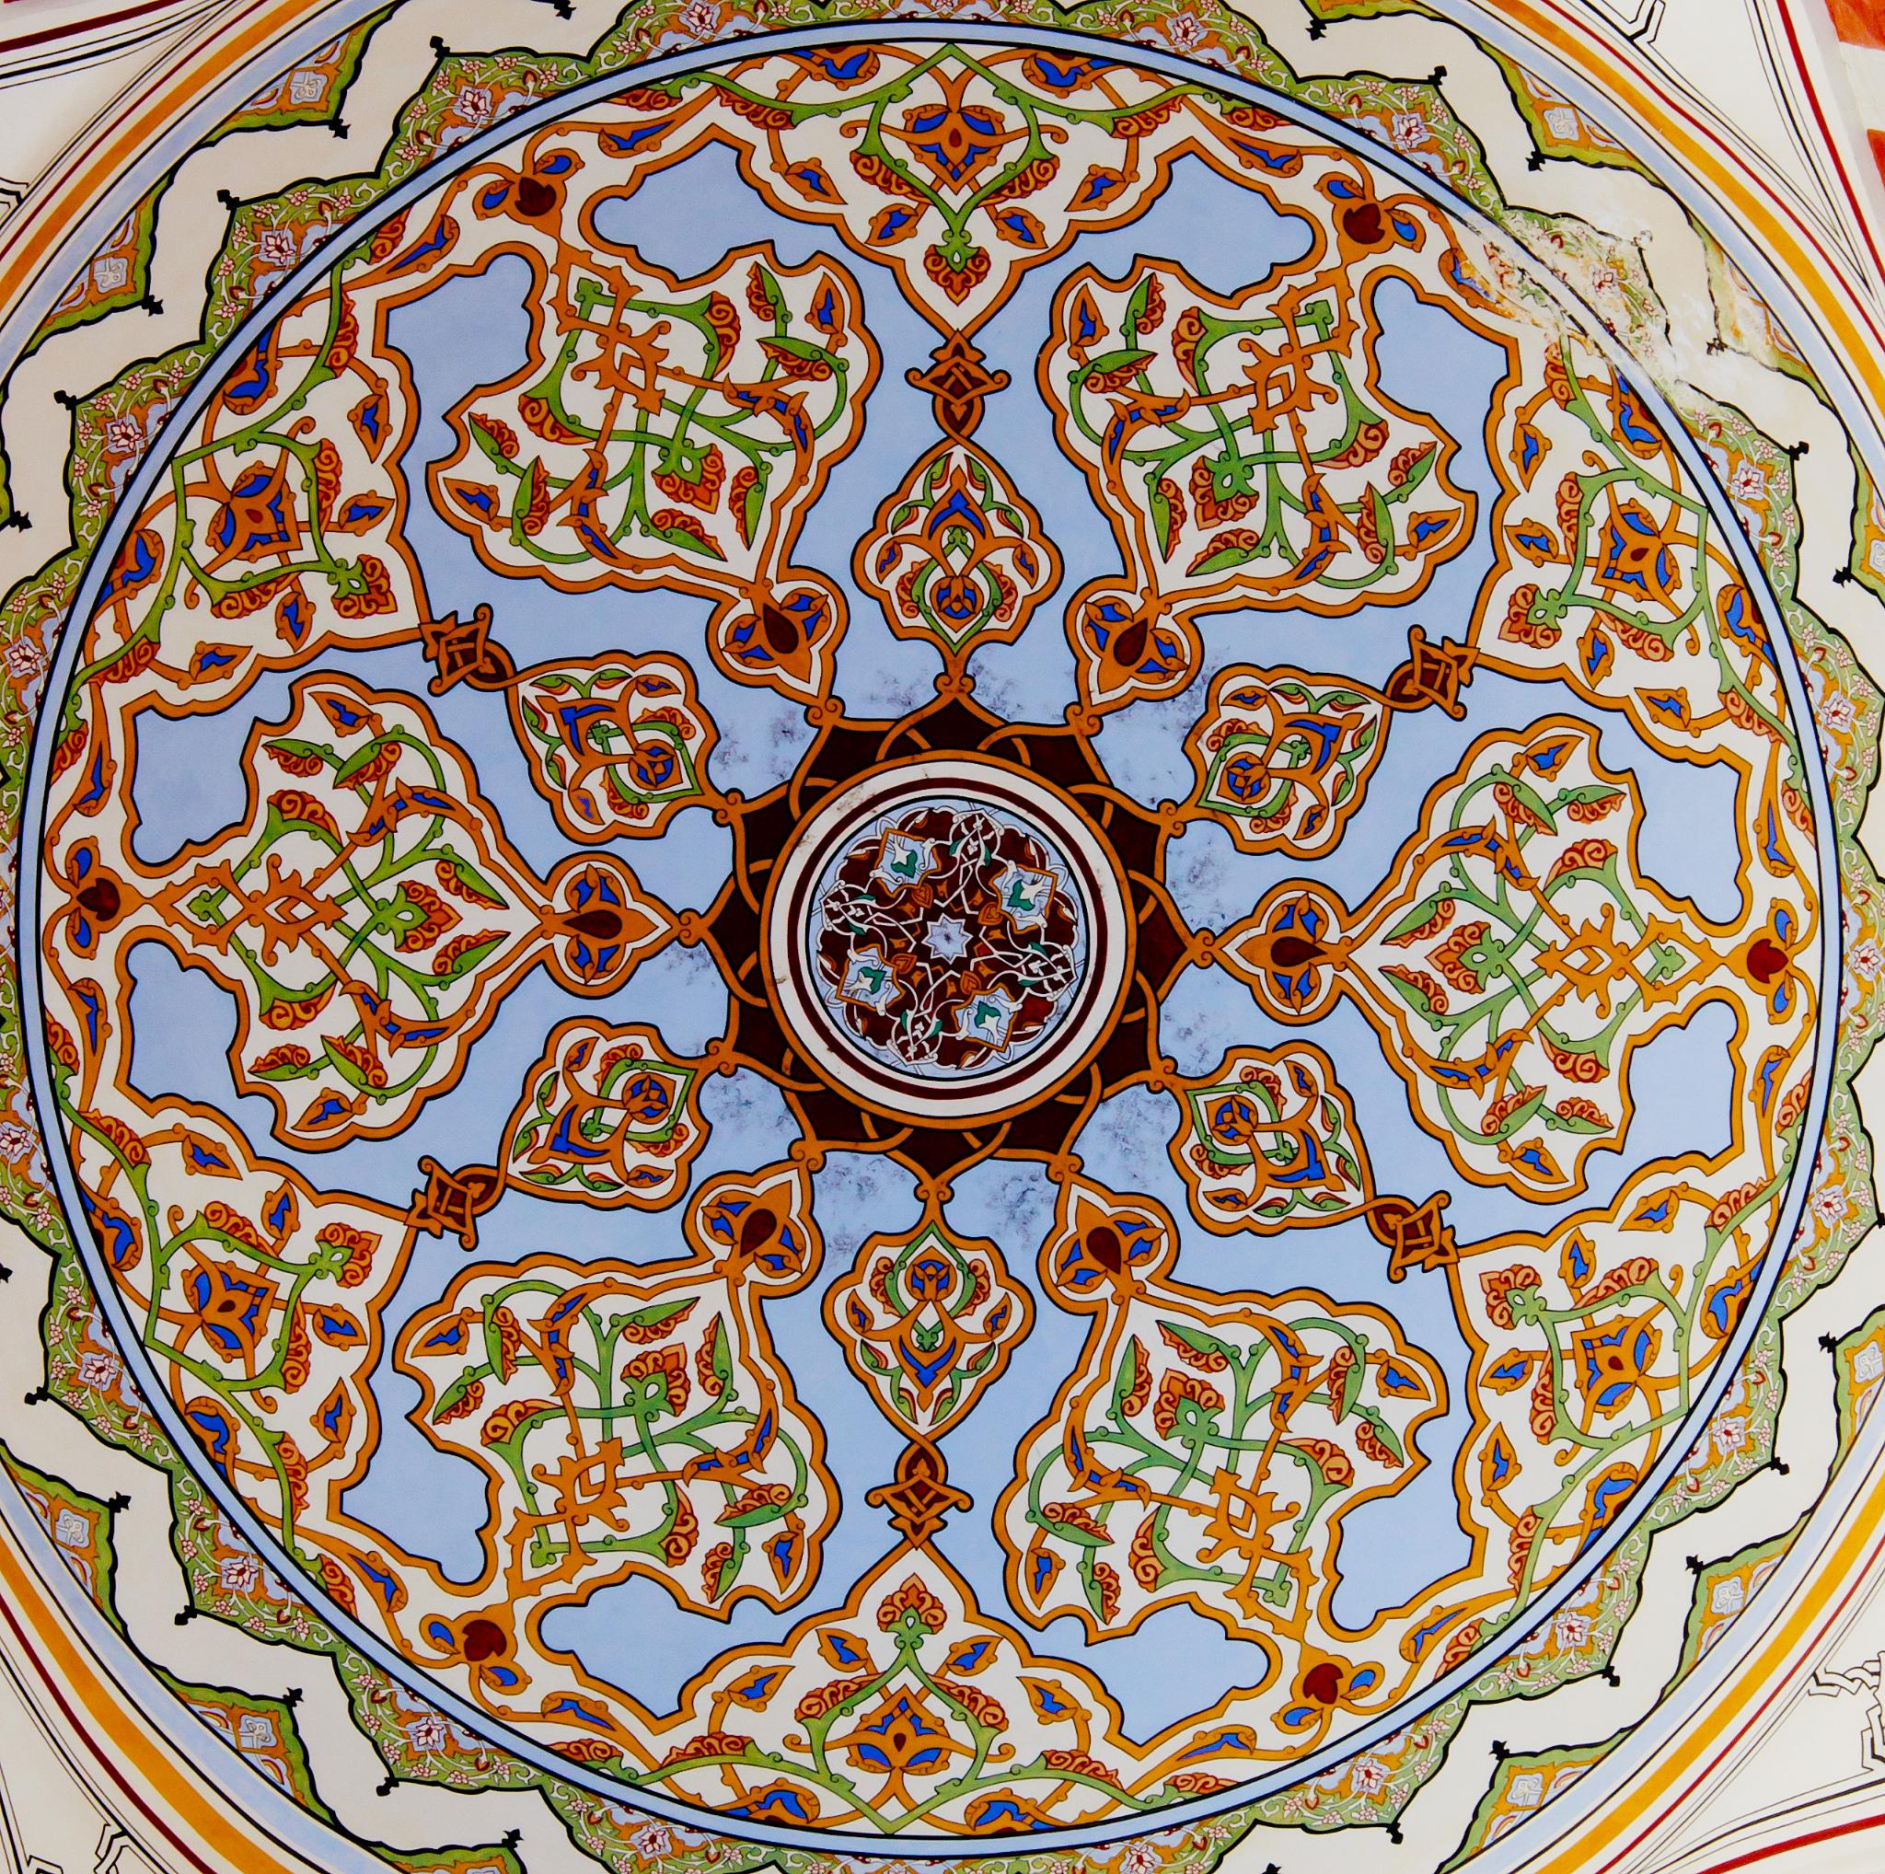
Fritware: The Islamic World's Elegant Answer to Chinese Porcelain
Distinctive ceramic art showcasing Islamic innovation and beauty
Notes:
---

Slide 2
What is Clay?

Slide 3
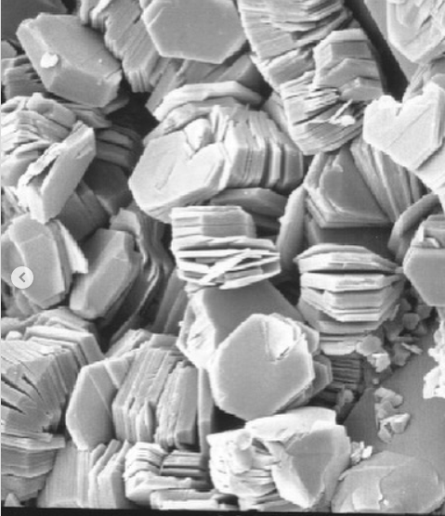
CLAY
Clay is a naturally occurring, fine-grained earthy material composed of one or more clay minerals, often with traces of quartz and metal oxides ( iron, magnesium, potassium, sodium, and calcium). It forms from the weathering of rocks like feldspar (granite) over long periods and has the unique property of becoming soft and plastic when wet, allowing it to be easily molded, but then hardening into a rock-like substance when dried or fired.
Under a microscope, clay appears as flat, thin, and often hexagonal-shaped platelets (tiny plates). These platelets are made of silica and alumina, and when wet, they can easily slide past one another, giving clay its characteristic plasticity and ability to be molded. Under an electron microscope, these microscopic plates are seen to form stacks, which contributes to why clay shrinks and can crack when it dries.
Silica, Alumina, Water+ other elements in small amounts
Looking for clay.

Slide 4
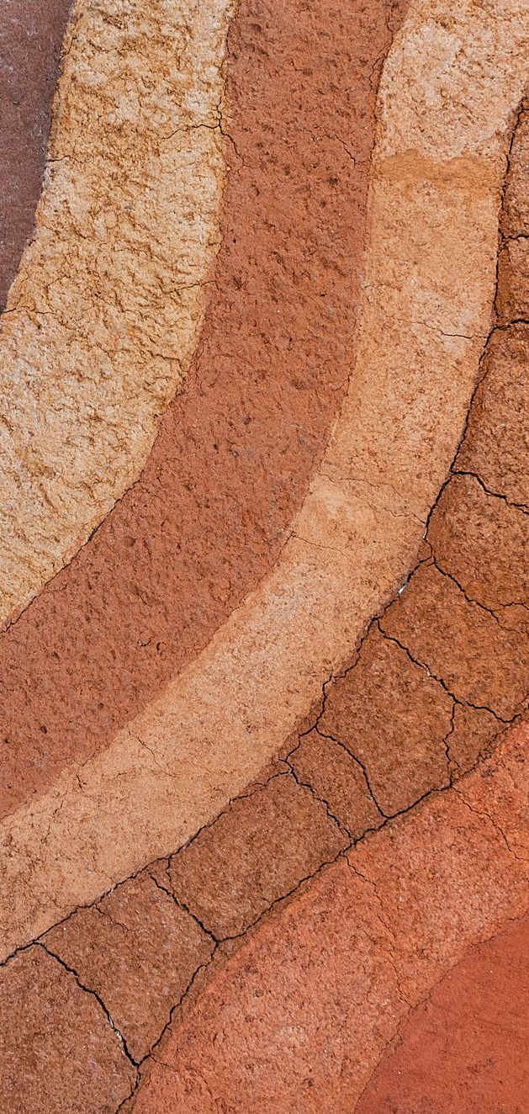
Types of CLAY Bodies
Earthenware: Fired in the range of 800°-900° Celsius. Earthenware is porous; unless the piece is glazed, capillary action will pull liquid through the porous walls. Earthenware ranges in earthtones from buff, grey, brown, white and black.
Stoneware: Fired to the range of 1100° – 1200° Celsius. Because of stoneware’s high firing temperature, the particles of silica in the clay body melt and fuse in a process known as vitrification, making stoneware impervious to liquids, even without glaze. Stoneware can also vary in color.
Porcelain: Employing two white clays, Kaolin and Petuntse (“China Stone”- low iron fusible feldspar mineral). Porcelain is fired in the range of 1300° -1400° Celsius. As with stoneware, porcelain’s high firing temperature results in vitrification, making it impervious to liquids even with out glaze. When properly mixed and fired, Kaolin and Petuntse create a fine grained, white ceramic ware that is translucent, due to its high silica content.

Slide 5
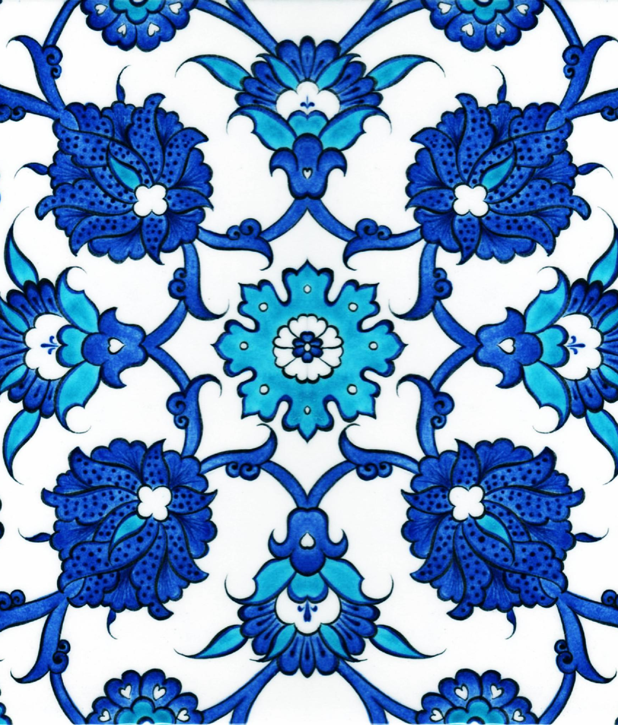
Fritware: The Islamic World's Elegant Answer to Chinese Porcelain
Origins of Porcelain
Through hundreds of years of technological innovation, the Chinese developed Porcelain. What makes Porcelain so special? Chinese porcelain was admired for its white body and durability and was widely imported into the Islamic world.
Origins of Fritware
  Fritware emerged as an innovative Islamic ceramic art form developed to rival Chinese porcelain. Fritware established a unique ceramic tradition inspired by porcelain, but adapted to local materials and techniques.
Material Composition
  Fritware is made using a unique blend of ground quartz, glass frit, and clay, creating a distinct ceramic body.
Decorative Techniques
  Islamic potters used intricate glazing and painting methods, producing elegant designs that became a hallmark of fritware. like cobalt blue underglaze, lusterware, and mina'i ware in fritware ceramics.
Notes:
Fritware represents a significant innovation in Islamic ceramic art, developed as a response to the highly prized Chinese porcelain. This presentation explores the origins, composition, and decorative techniques of fritware, highlighting how it served as a cultural and technological answer to the challenges posed by importing and replicating Chinese porcelain. Through this lesson, we will delve into the historical context of fritware's emergence, examine its unique material composition, and appreciate the artistic techniques that made it a hallmark of Islamic ceramic tradition.

Slide 6
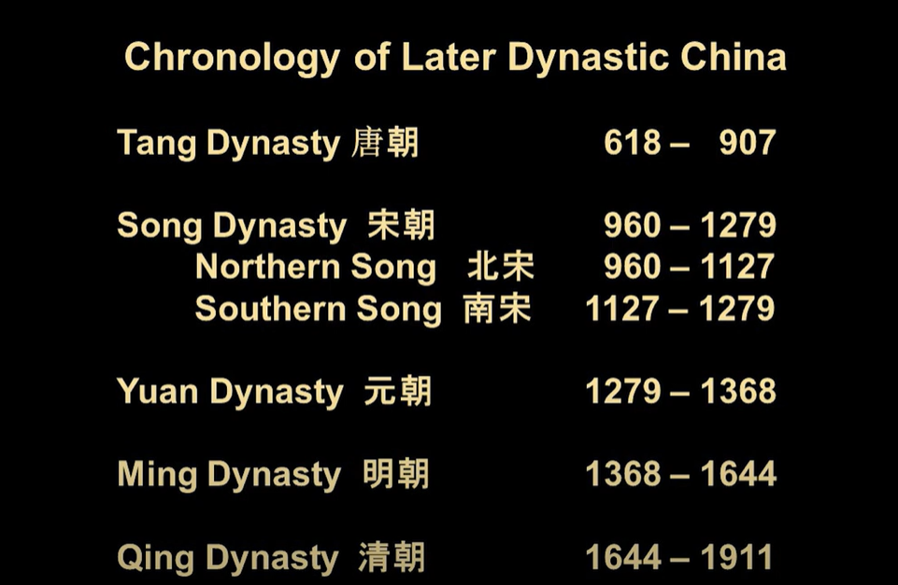
Chinese Porcelain
The first true, high-fired translucent porcelain was developed by the Tang Dynasty (618–907 CE).
From the 9th century onwards, Islamic merchants started to import Chinese ceramics via the Indian Ocean Silk Road routes , These exotic objects were cherished in the Islamic world and became an inspiration for local potters.
Tang Dynasty Chinese Porcelain has been found in present day Iraq (Samarra and Ctesiphon) and Iran (Nishapur).
Chinese traded silk, ceramics, tea, spices, paper
In return the middle east traded horses, glassware, wool, food, spices, gold, silver and cobalt.

Slide 7
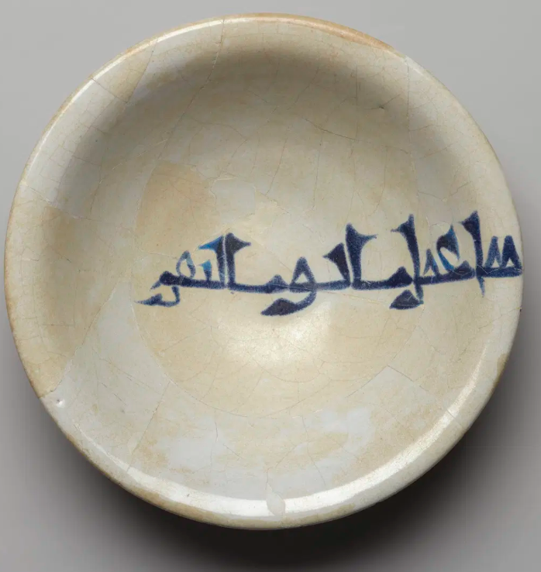
COBALT BLUE
Bowl with Kufic Inscription, 9th century. Ceramic; earthenware, painted in cobalt blue on an opaque white glaze, 2 1/2 x 8 5/8 in. (6.4 x 21.9 cm). Brooklyn Museum

Slide 8
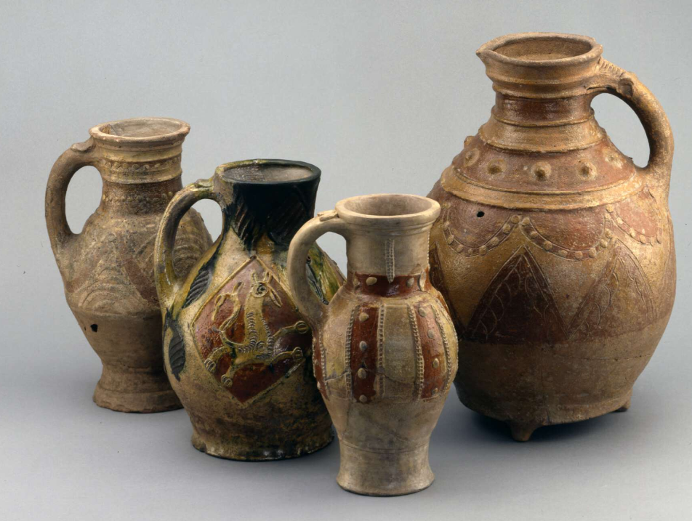
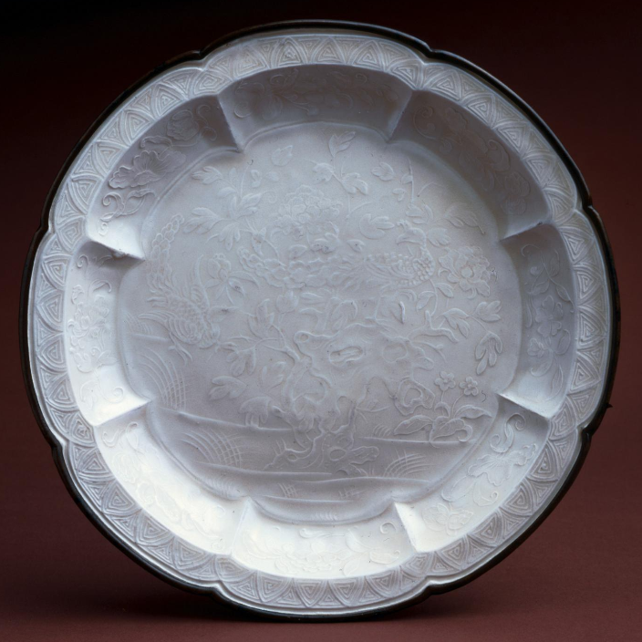
Europe VS. China
1226- 1275 England Earthenware (British Museum)
960-1234 Northern Song Dynasty Porcelain (BM)

Slide 9
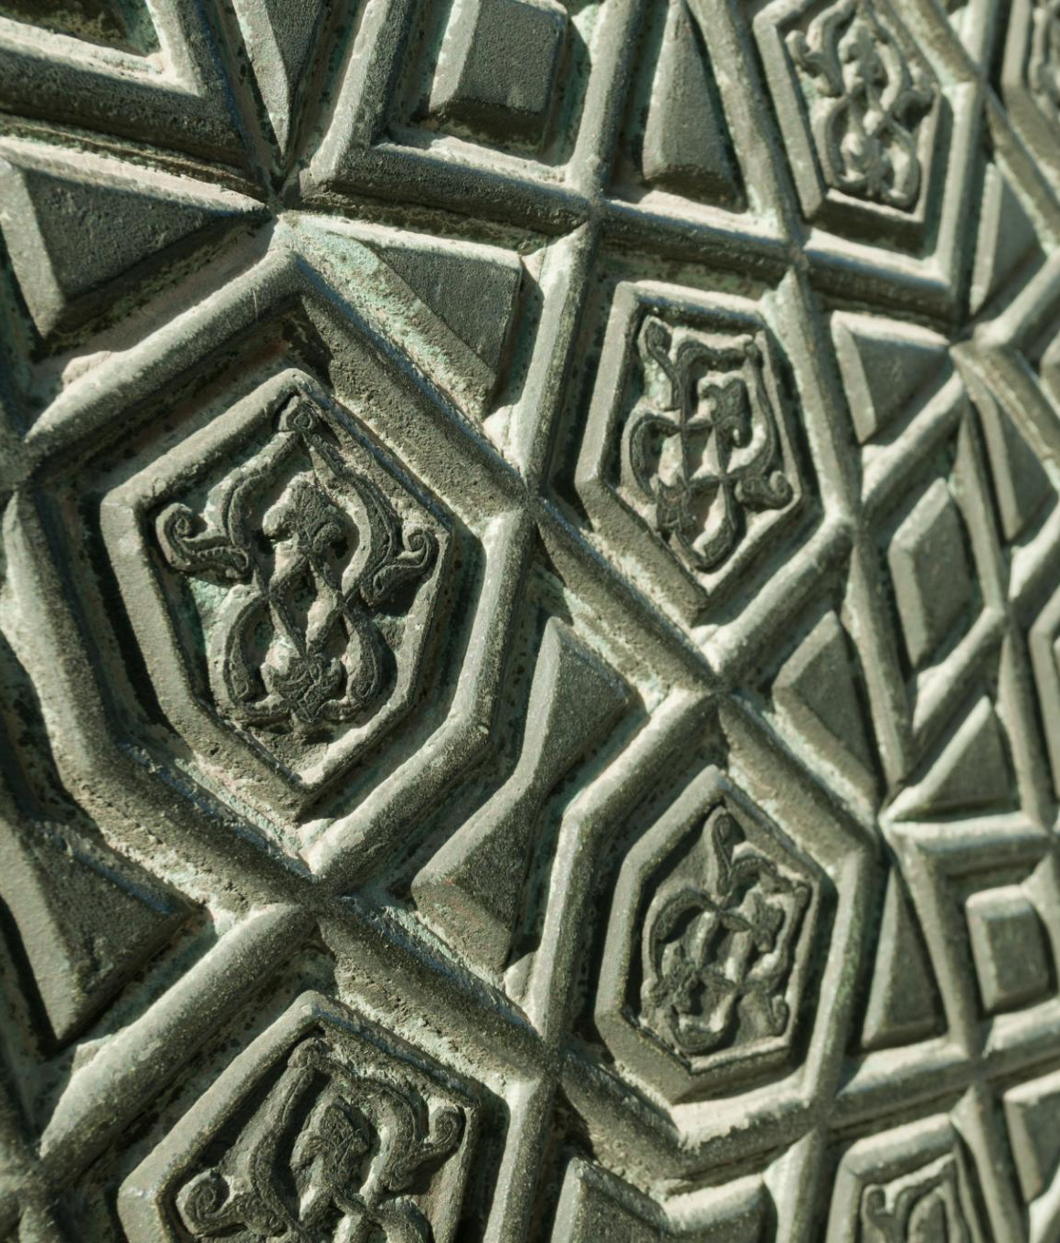
What is Fritware?
Definition and Composition
  Fritware is a ceramic made from ground quartz, white clay, and glassy flux, resulting in a smooth white body ideal for decoration.
  Abu'l Qasim Kashani's treatise on ceramics
  historian of the reign of the Il-khan Olǰāytū (r. 703-16/1304-16) and member of the Abū Ṭāher family of potters.
  https://web.archive.org/web/20150313123951/http://islamicceramics.ashmolean.org/Glossary/abulqasim.htm
  Comparison to Porcelain
  Unlike porcelain, fritware requires lower firing temperatures and more accessible raw materials like quartz and white clay.
Cultural and Artistic Significance
  Fritware allowed Islamic artisans to create unique decorative styles reflecting their culture, inspired by but distinct from Chinese porcelain.
Notes:
Fritware is a type of ceramic developed in the Islamic world as a substitute for Chinese porcelain. It is composed primarily of ground quartz (frit), mixed with white clay and a glassy flux to bind the materials. This composition results in a smooth, white ceramic body that is ideal for painting and glazing. Unlike porcelain, which requires high firing temperatures and specific clays like kaolin, fritware could be produced with more readily available materials and lower firing temperatures. This innovation not only allowed Islamic artisans to emulate the aesthetic qualities of porcelain but also enabled them to develop unique decorative styles that reflected their own cultural and artistic values.

Slide 10
Artistic Techniques and Case Studies
Notes:
Decorative Techniques, Case Studies

Slide 11
Decorative Techniques
  Islamic potters used intricate glazing and painting methods, producing elegant designs that became a hallmark of fritware. like cobalt blue underglaze, lusterware, and mina'i ware in fritware ceramics.
Cobalt Blue Underglaze
  This technique features intricate blue designs painted beneath a transparent glaze, inspired by Chinese porcelain. Or Chinese were inspired by the middle east?
Lusterware Metallic Sheen
  Lusterware creates a metallic sheen by applying metal oxides and a second firing in a reduction kiln. First used 9th century Iraq
  Mina’i Polychrome Painting
  Mina’i ware uses colorful overglaze enamel painting often depicting narrative scenes with human and animal figures.

Slide 12
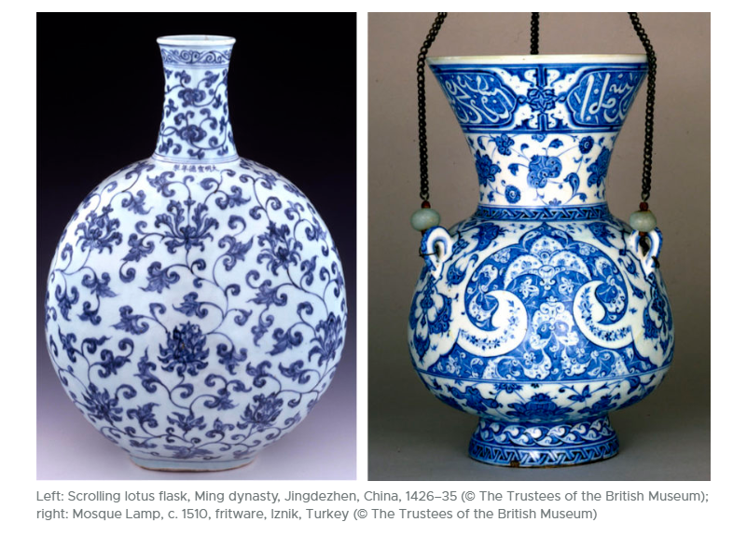
COBALT BLUE UNDERGLAZING

Slide 13
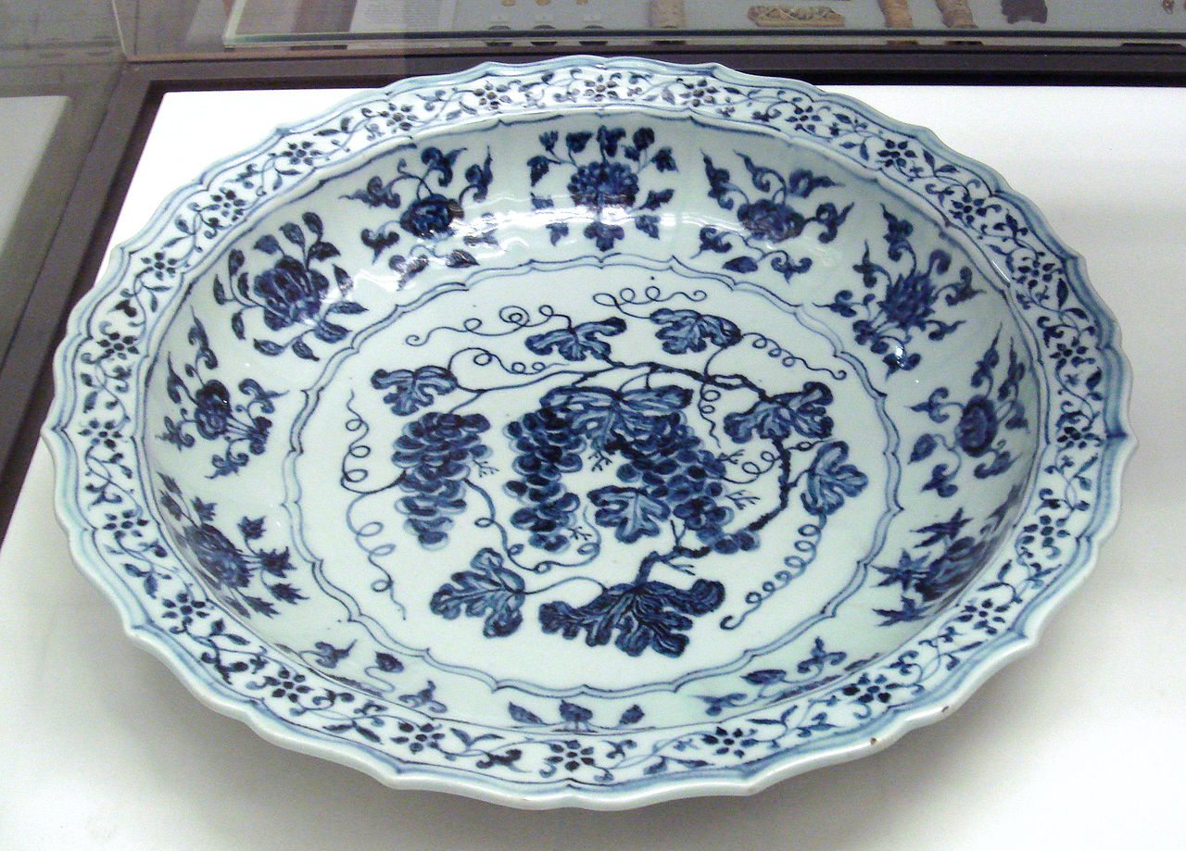
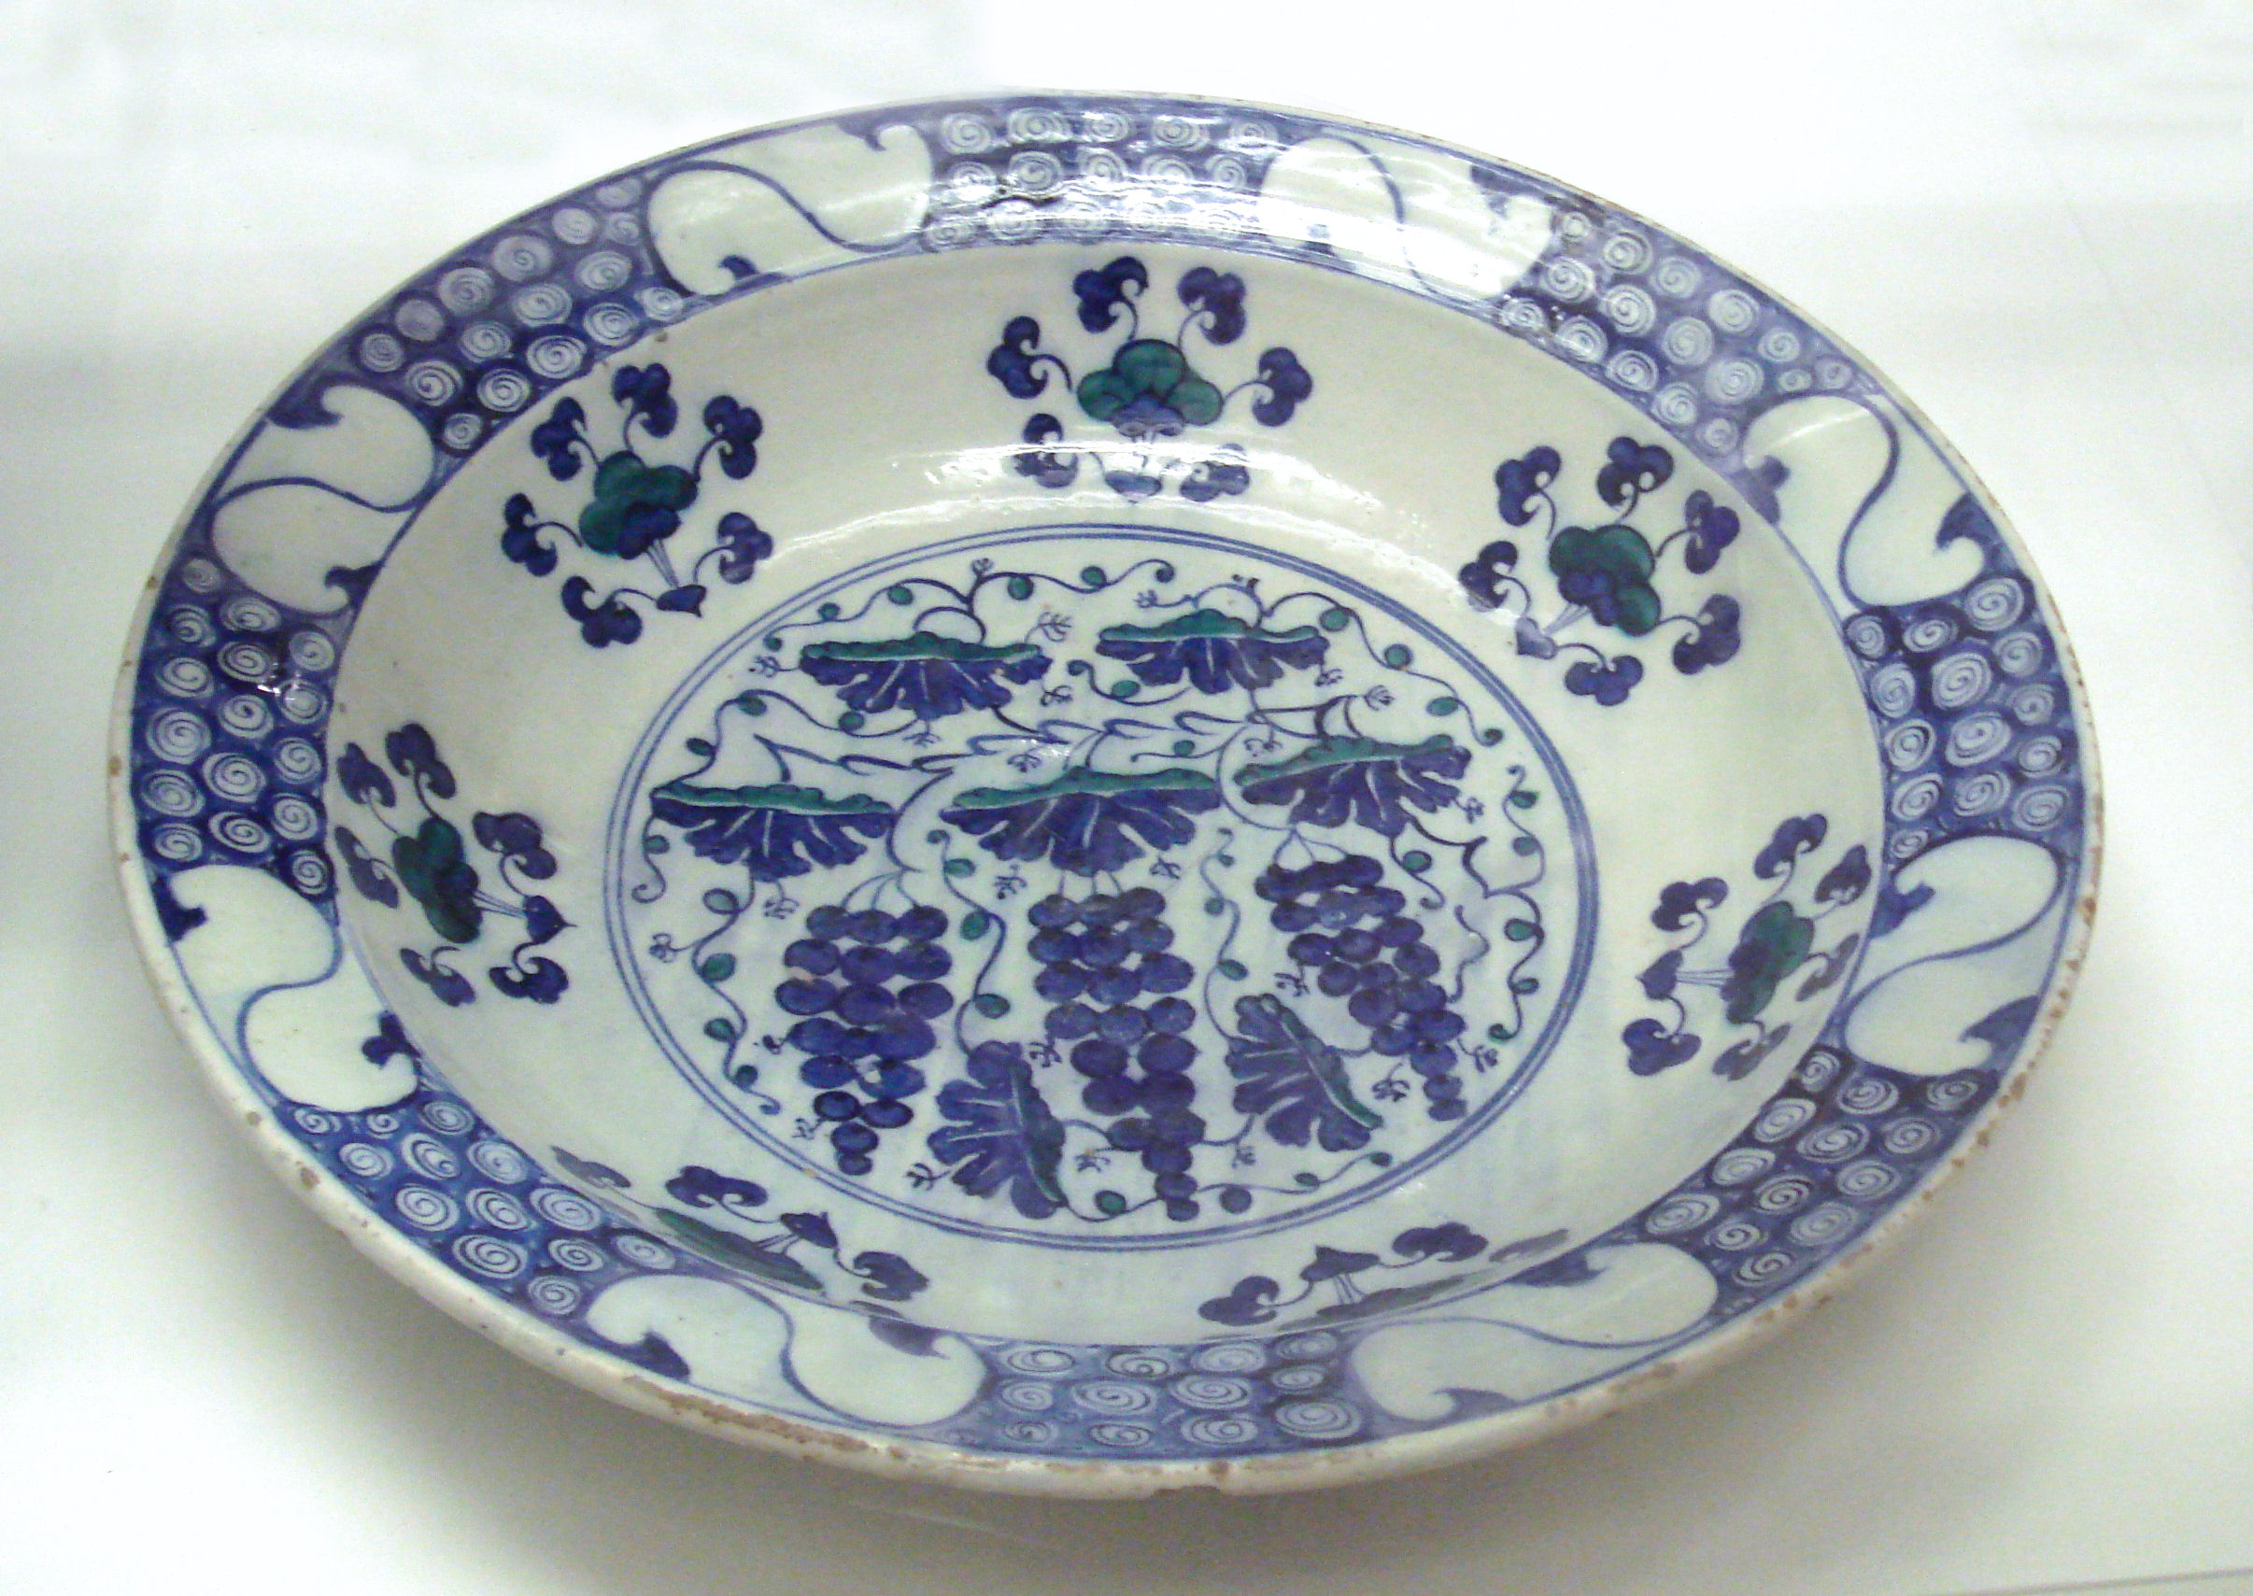
Left image: Ming plate with grape design, 15th century, Jingdezhen kilns, Jiangxi. British Museum.
Right image: Stone-paste dish with grape design, and "dollar pattern" border, Iznik, Turkey, 1550–70. British Museum.

Slide 14
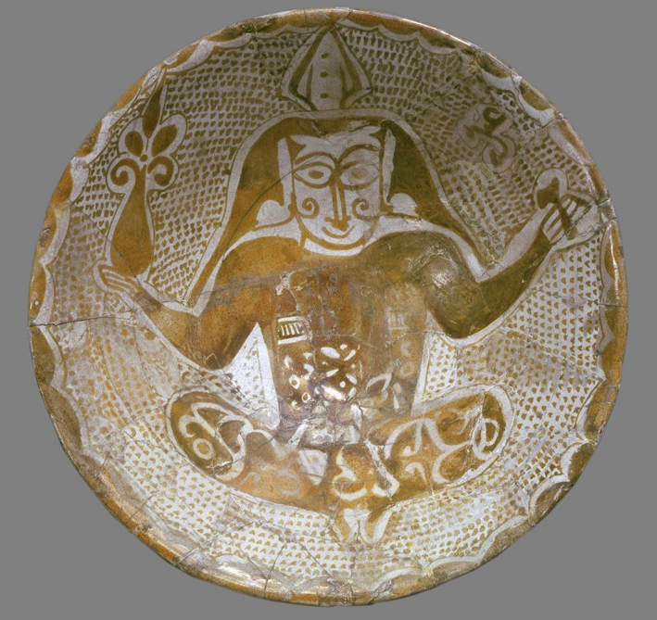
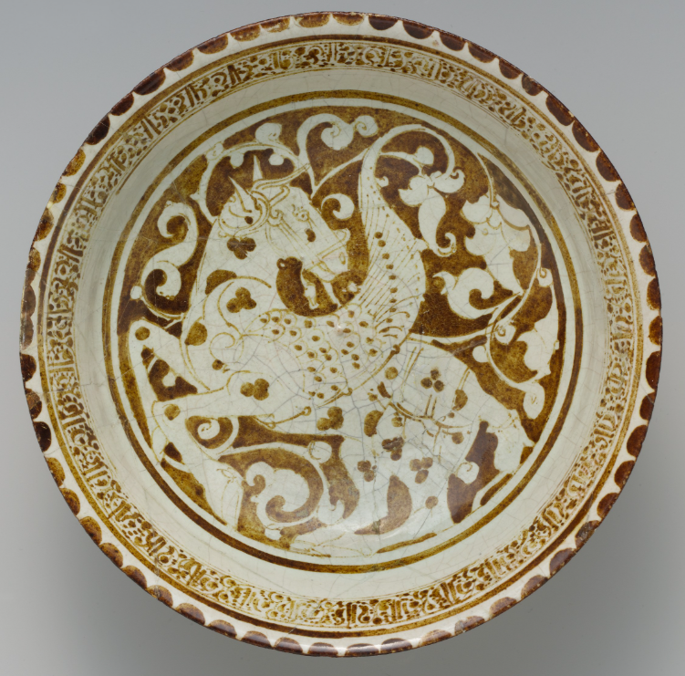
Lusterware
Iraq 10th century (Ashmoleon)
Iran 12th Century (Met)

Slide 15
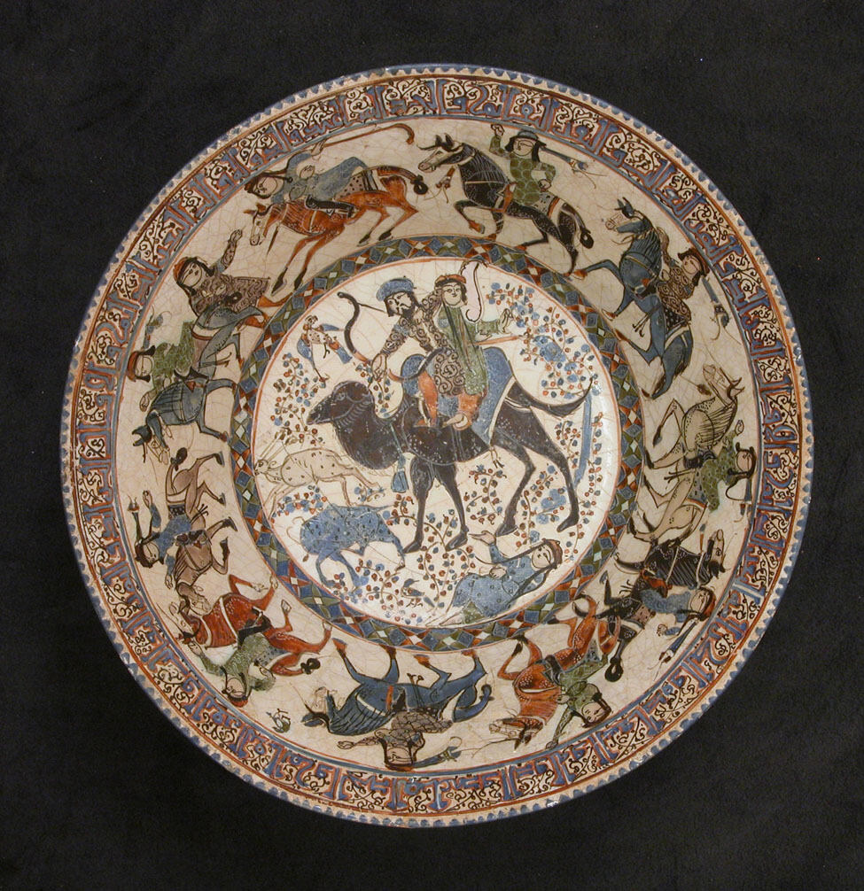
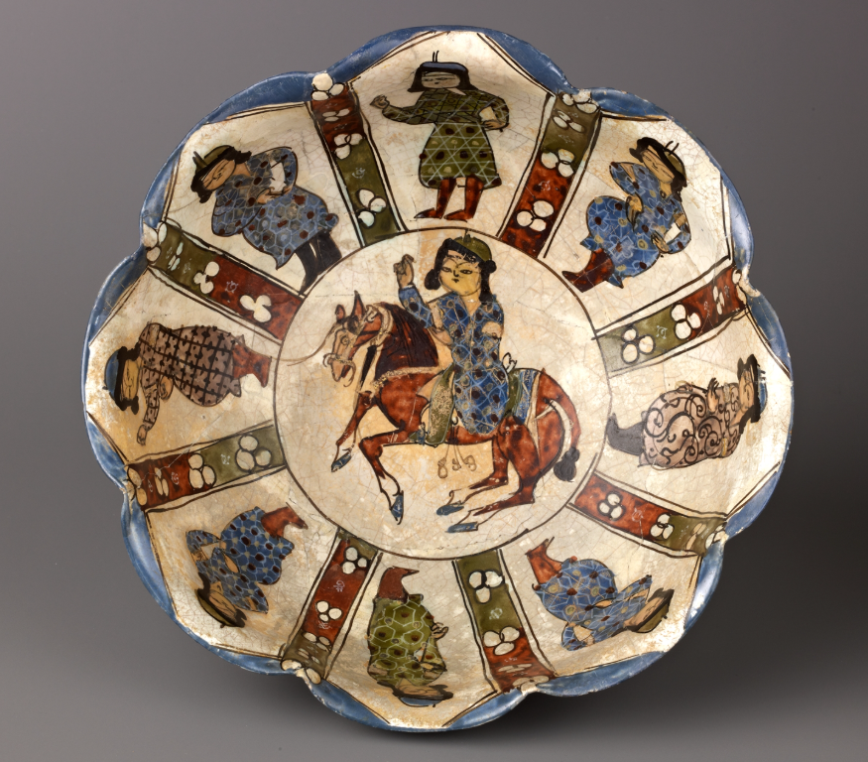
Mina’i Polychrome
Iran 12th–13th century Bahram Gur and Azada (met)
Iran early 13th Century (Met)

Slide 16
Engagement and Reflection
Notes:
Activity, Conclusion

Slide 17
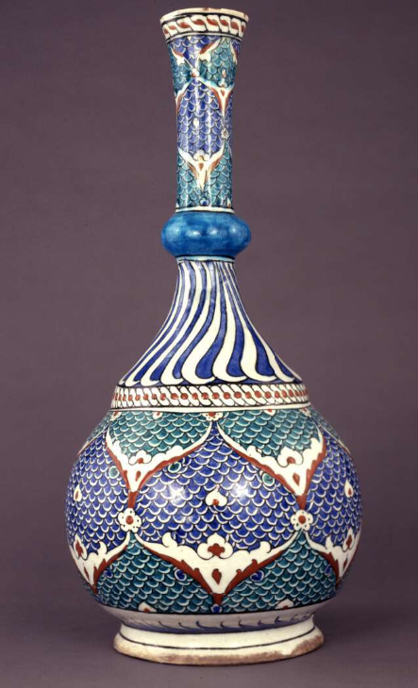
Conclusion
Fritware's Artistic Excellence
  Fritware showcases the Islamic world's creativity, replicating and enhancing the beauty of Chinese porcelain.
Cultural Exchange Impact
  Fritware development highlights how cultural interactions inspire both technological and artistic innovations.
Art as a Bridge
  Art serves as a medium connecting civilizations and expressing diverse cultural identities.
Iznik 1580-1585 (Ottoman Dynasty) British Museum
Notes:
In conclusion, fritware stands as a testament to the Islamic world's ingenuity and artistic excellence. Developed in response to the allure of Chinese porcelain, fritware not only replicated its aesthetic qualities but also introduced new decorative techniques that enriched Islamic art. Through this lesson, students have explored the historical context, material composition, and artistic innovations of fritware. They have also examined how cultural exchange can inspire technological and creative advancements. By reflecting on these themes, students gain a broader understanding of how art serves as a bridge between civilizations and a medium for cultural expression.

